Slide 1
BOM MOVIE
As we navigate the challenges and opportunities facing the movie industry in today's digital age. Whether you're a seasoned industry professional or simply a movie enthusiast, BOM MOVIE aims to provide valuable insights into this fascinating world.

Slide 2
INTRODUCTION
Welcome to BOM MOVIE, your guide to understanding the dynamic world of the movie business! The movie industry, also known as the film industry, holds a unique position in the realm of entertainment, captivating audiences worldwide with its compelling storytelling and visual artistry.

Slide 3

OVERVIEW
The Movie Data Analysis and Recommendation System is a data-driven project that aims to explore, analyze, and provide recommendations based on a dataset of movie-related information. This project combines data analysis, visualization, and machine learning techniques to extract valuable insights from the movie data and assist users in making informed decisions about which movies to watch.

Slide 4
BUSINESS UNDERSTANDING
DATA COLLECTION
Gather movie-related data from various sources, such as online databases, APIs, or CSV files.
Collect information about movie titles, release dates, genres, ratings, cast and crew, box office earnings, and more
DATA CLEANING AND PROCESSING
Clean the dataset to handle missing values, duplicate entries, and inconsistent data.
DATA VISUALIZATION
Create interactive data visualizations to present key findings and trends.
Visualize movie ratings, box office performance, genre distributions, and more.
USER INTERFACE
Develop a user-friendly interface (web application or mobile app) where users can input their preferences and receive movie recommendations.
Allow users to search for movies, view details, and read reviews.
STATISTICAL ANALYSIS
Analyze factors influencing movie success, such as the impact of actors, directors, and release timing.
RECAND DOCUMENTATION

Slide 5
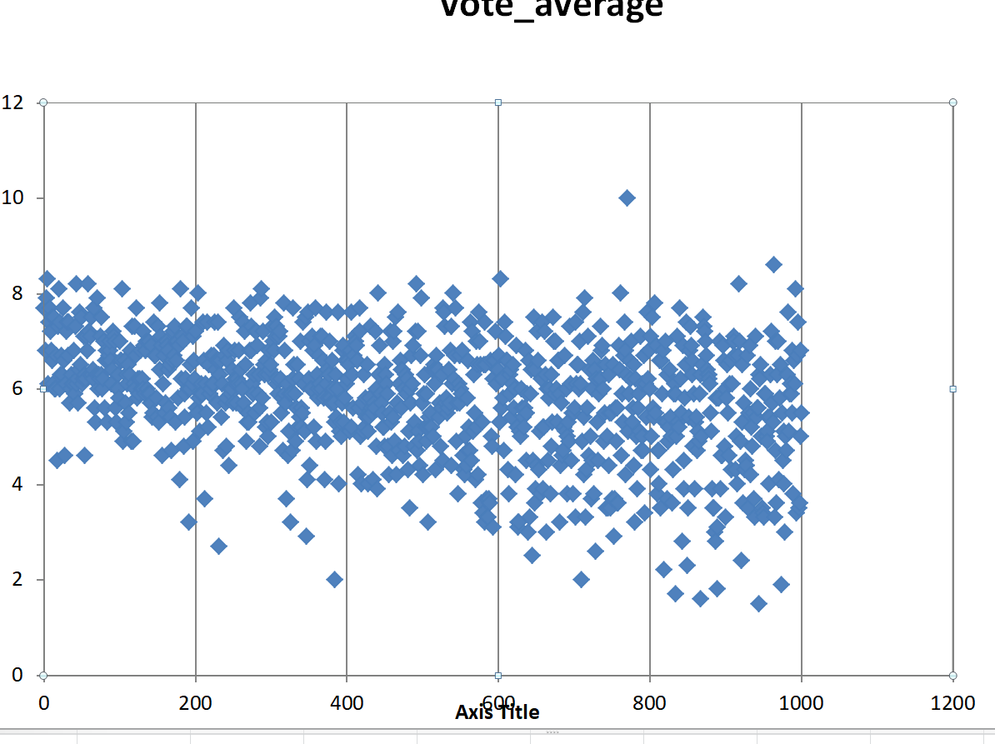

Slide 6
PROBLEM STATEMENT
Missing Data:
Missing values in the dataset can be a common problem. Information about certain movies, such as box office revenue, may not be available for all entries. Handling missing data appropriately is crucial to avoid bias in the analysis.
Data Quality:
Inaccurate or inconsistent data can pose challenges. This may include misspelled movie titles, incorrect release dates, or inconsistent naming conventions for genres and cast members. Data cleaning and validation are essential steps to ensure data quality.
Data Volume:
Movie data can be vast, especially if it spans many years and includes a large number of films. Managing and processing large datasets efficiently can be a computational challenge.
Data Integration:
Movie data often comes from multiple sources, each with its own format and structure. Integrating data from different sources and ensuring data consistency can be complex.

Slide 7
ANALYSIS (EDA)
Summary Statistics:
Calculate summary statistics for relevant variables such as box office revenue, budget, release date, and user ratings. This includes measures like mean, median, standard deviation, and percentiles
Genre Analysis:
Analyze the distribution of movie genres. You can create bar charts or pie charts to show the prevalence of different genres in the dataset. Identify popular and less common genres.
Release Date Analysis:
Explore trends related to movie release dates. You can create time series plots to visualize how the number of movies released or box office revenue has changed over the years or seasons.
Data Cleaning:
Address missing data, duplicate entries, and inconsistent values in the dataset. Ensure data quality for meaningful analysis.
Market Segmentation:
Segment the dataset based on different criteria, such as genres, production companies, or release regions. Analyze each segment separately to identify specific trends.

Slide 8
OBJECTS
Enhanced Decision-Making:
Improve decision-making processes in the movie industry by providing data-driven insights that inform production, marketing, and distribution strategies.
Market Segmentation:
Segment the movie market to tailor content and marketing efforts to specific audience segments.
Data Quality:
Ensure that data collected is accurate, complete, and reliable. Implement data validation and cleansing processes to maintain data quality.
Ethical Use of Data:
Follow ethical guidelines in data collection and analysis, respecting the rights and consent of individuals whose data is involved.
Accessibility:
Ensure that data insights are accessible to all relevant stakeholders in a user-friendly manner.

Slide 9
CONCLUSIONS AND RECOMMENDATIONS
Optimize Release Timing:
Based on historical data analysis, recommend specific release dates for upcoming movies to maximize box office revenue. Consider factors such as genre, competition, and holiday seasons.
Data-Driven Marketing:
Advise on data-driven marketing strategies, including personalized content recommendations and targeted advertising campaigns.
Impact of Factors:
Highlight the impact of factors such as cast, genre, release date, and marketing on movie performance
Invest in High-Performing Genres:
Suggest allocating resources to movie genres that have consistently performed well in terms of both critical acclaim and box office revenue

